Slide 1
From domain-centric requirements specification to choreography synthesis
(FP7 CHOReOS presentation)
Marco Autili
University of L’Aquila - ITALY
Dublin 2013 – May 07th

Slide 2

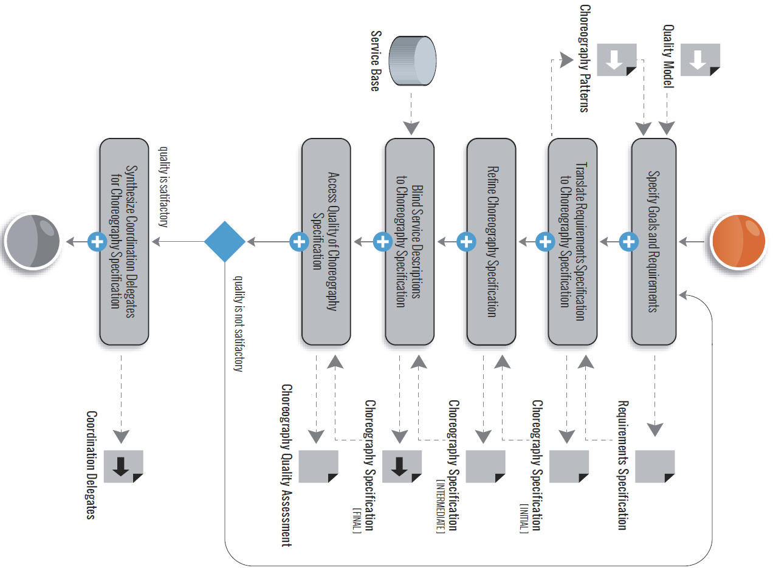
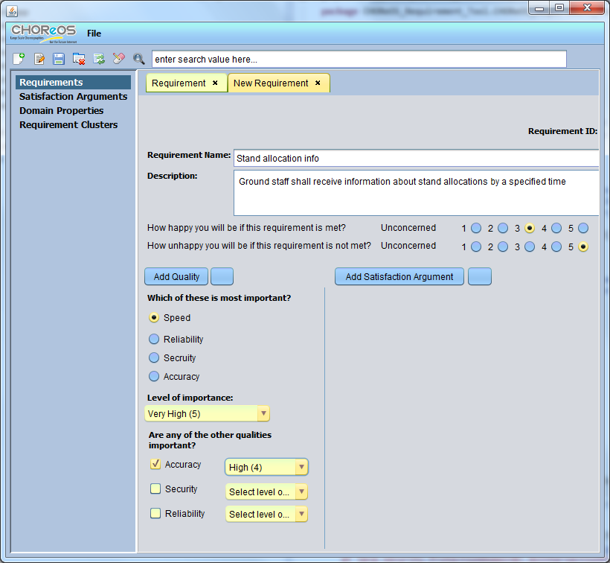
Development of
choreography-based
service-oriented systems
(development phase roadmap)

Slide 3
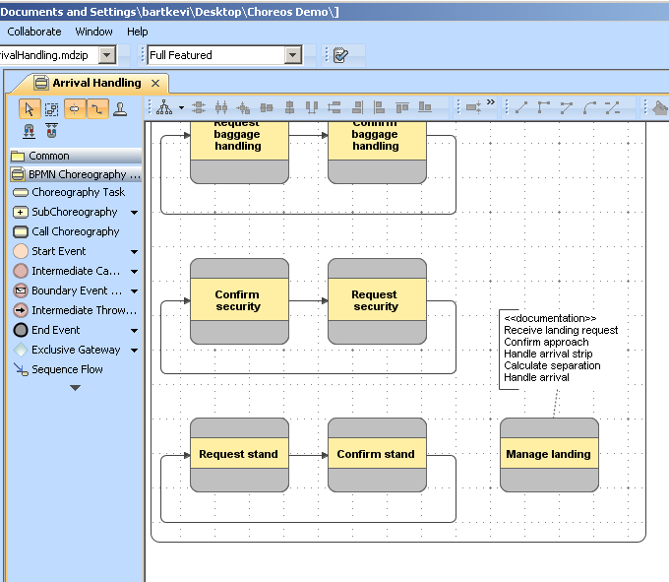
Development of
choreography-based
service-oriented systems
(development phase roadmap)

Slide 4
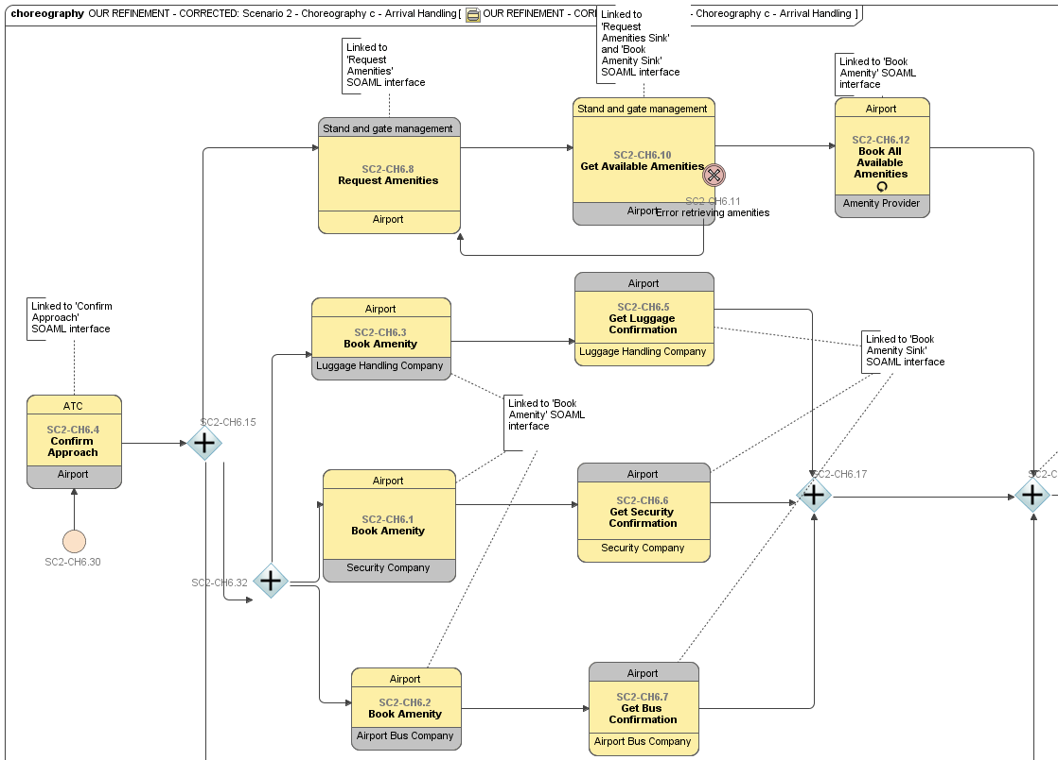
Development of
choreography-based
service-oriented systems
(development phase roadmap)

Slide 5
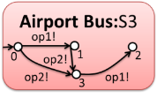
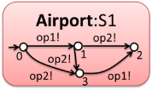
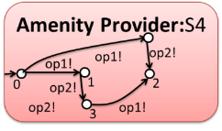
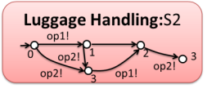
Development of
choreography-based
service-oriented systems
(development phase roadmap)

Slide 6

Development of
choreography-based
service-oriented systems
(development phase roadmap)

Slide 7
Development of
choreography-based
service-oriented systems
(development phase roadmap)
CD1
CD2
CD4
CD5
CD2
CD3

Slide 8
From requirements to BPMN2
Domain expert specification of requirements and service choreography design
  Expressing functional and quality requirements on a service-based system
  Clustering relevant requirements to specify a single choreography
  Matching requirements on a choreography to a catalogue of user task models which inform the design of a first-cut service choreography
  Refining the choreography specification

Slide 9
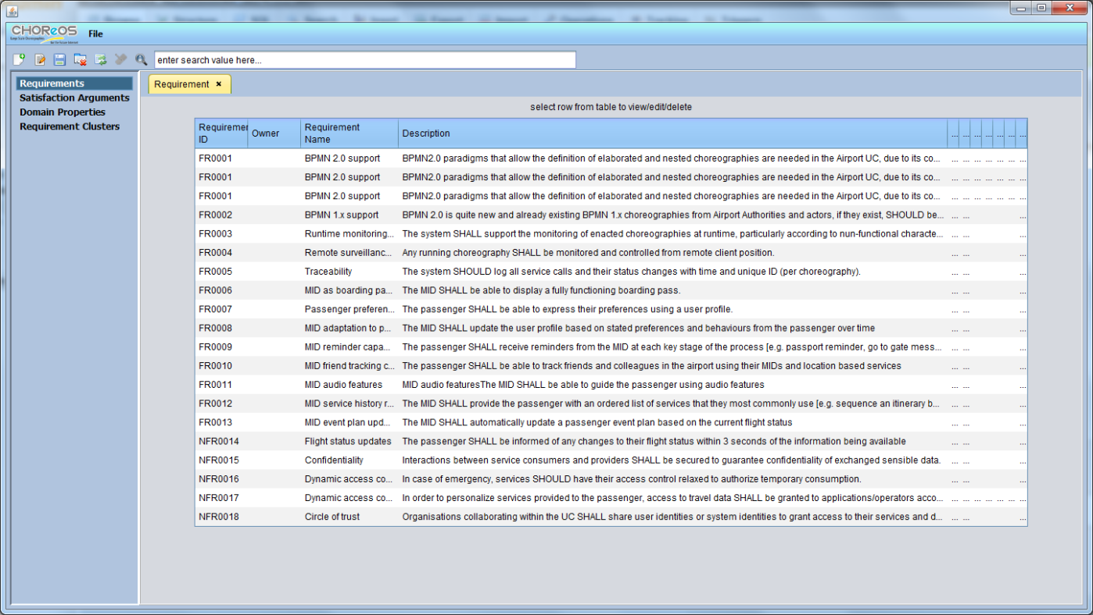
Expressing Quality Requirements
CHOReOS Requirements Tool
  Supports the domain expert to express quality requirements and their level of importance

Slide 10
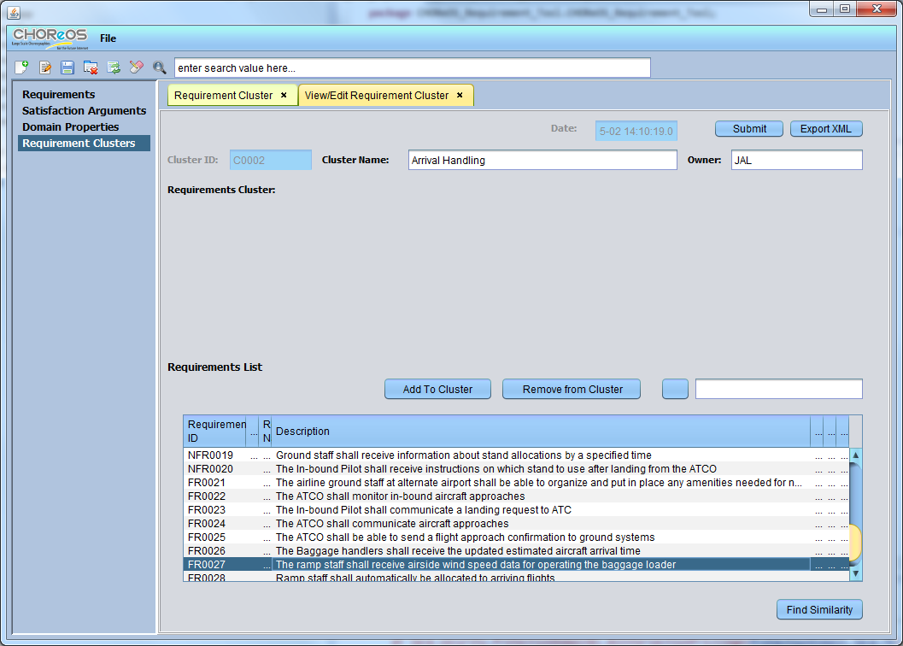
Clustering Requirements
Create cluster of requirements that will map on a single choreography
Similarity algorithm which generates a measure of semantic similarity and find similar requirements to the selected requirement

Slide 11

Retrieving User Task Models
  The cluster of requirements is matched to a catalogue of CTT models using a service called TEDDiE
  The retrieved CTT models are returned with the matched requirements
Cluster of requirements
(XML request)
TEDDiE Matching
(sophisticated information retrieval techniques)
Relevant CTT models and matched requirements
(XML results)
ConcurTaskTrees
(CTT) library
CTT-based choreography specification
+
Associated requirements
and Attributes
(MagicDraw tool)
Domain-independent models
developed in S-Cube
(EU-funded Network of Excellence
for Software Services)

Slide 12
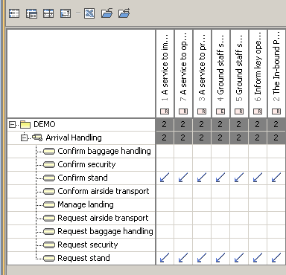
Initial BPMN2 Choreography Model
Associated requirements
and attributes
Dependency Matrix
(links between requirements and choreography tasks)

Slide 13
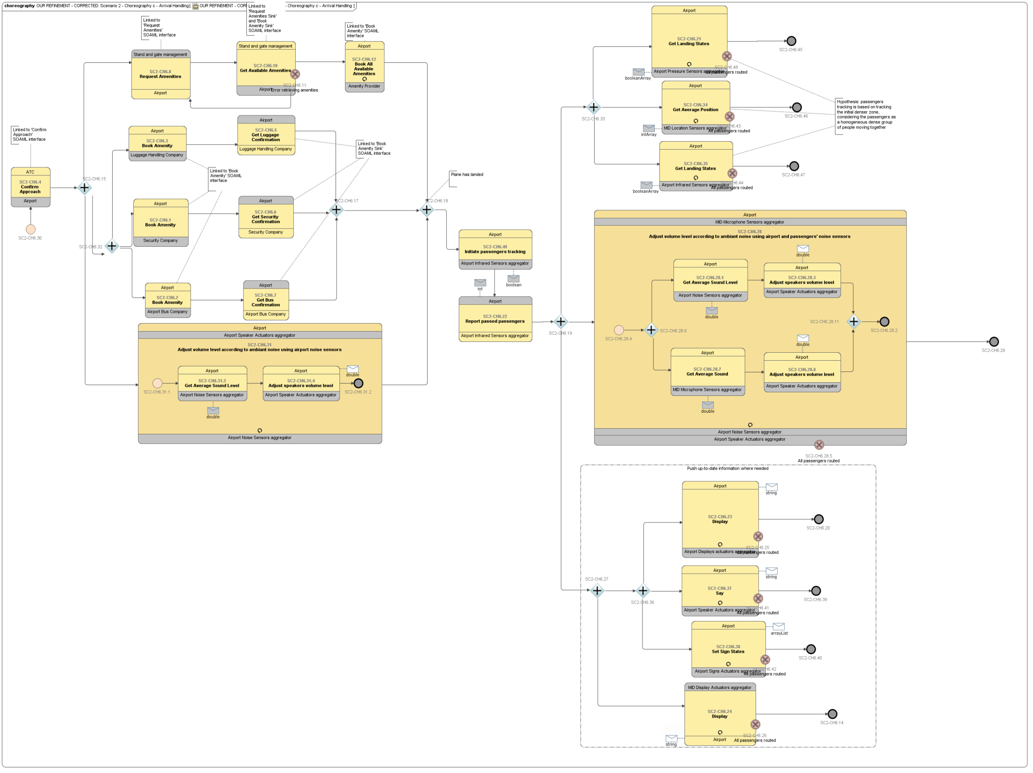
Final BPMN2 Choreography of the
Airport use case
(Arrival Handling scenario)
  Standard de facto
  for specifying choreographies
  Dedicated notation called
  Choreography Diagrams

Slide 14
Development of
choreography-based
service-oriented systems

Slide 15
Discovery, quality assessment and synthesis
Domain expert specification of requirements and initial service choreography design
  Discovering services
    to find services suitable to play the roles of the choreography
  Assessing quality
    to evaluate the performance of the choreography that might be affected by various factors
    (e.g., response time, slow services, unoptimised data flow)
  Synthesizing coordination delegates
    to automatically synthesize a distributed choreographer to be then used to enact the specified choreography

Slide 16

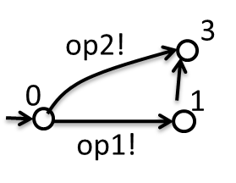

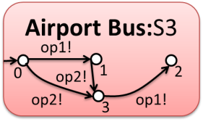
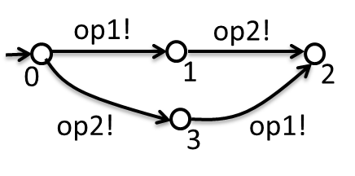
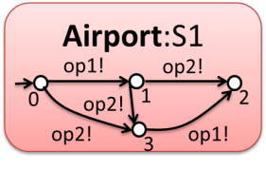

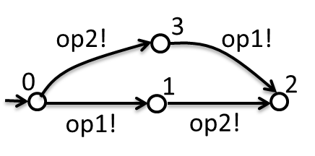
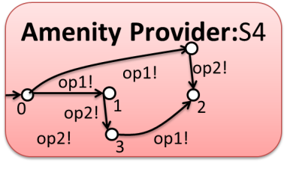
Service Discovery (and Synthesis Processor)
Synthesis
Process
Service
Discovery
simulates
simulates
simulates
simulates
Undesired interactions

Slide 17
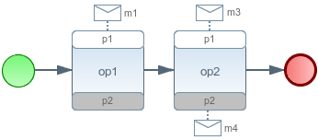
Undesired interactions
Undesired interactions are those interactions that do not belong to the set of interactions modeled by the given choreography and that can happen by letting the discovered services to collaborate in an uncontrolled way
CONSUMER (playing the role p1)
PROVIDER (playing the role p2)
p1:S1
p2:S2
op1!
op2!
op1?
op2?
0
1
2
0
1
2
op2!
op1!
op2?
3
op1?
3
CHOREOGRAPHY BPMN2
CHOREOGRAPHY LTS
p1.op1(m1).p2
p1.m4::op2(m3).p2
0
1
2

Slide 18
Undesired interactions
Undesired interactions are those interactions that do not belong to the set of interactions modeled by the given choreography and that can happen by letting the discovered services to collaborate in an uncontrolled way
CONSUMER (playing the role p1)
PROVIDER (playing the role p2)
p1:S1
p2:S2
op1!
op2!
op1?
op2?
0
1
2
0
1
2
op2!
op1!
op2?
3
op1?
3
CHOREOGRAPHY BPMN2
CHOREOGRAPHY LTS
p1.op1(m1).p2
p1.m4::op2(m3).p2
0
op1
1
op2
2

Slide 19
Undesired interactions
Undesired interactions are those interactions that do not belong to the set of interactions modeled by the given choreography and that can happen by letting the discovered services to collaborate in an uncontrolled way
CONSUMER (playing the role p1)
PROVIDER (playing the role p2)
p1:S1
p2:S2
op1!
op2!
op1?
op2?
0
1
2
0
1
2
op2!
op1!
op2?
3
op1?
3
CHOREOGRAPHY BPMN2
CHOREOGRAPHY LTS
p1.op1(m1).p2
p1.m4::op2(m3).p2
0
op2
1
op1
2

Slide 20
Undesired interactions
Undesired interactions are those interactions that do not belong to the set of interactions modeled by the given choreography and that can happen by letting the discovered services to collaborate in an uncontrolled way
CONSUMER (playing the role p1)
PROVIDER (playing the role p2)
p1:S1
p2:S2
op1!
op2!
CD1.2
op1?
op2?
X
0
X
1
2
0
1
2
op2!
op1!
op2?
3
op1?
3
CHOREOGRAPHY BPMN2
CHOREOGRAPHY LTS
p1.op1(m1).p2
p1.m4::op2(m3).p2
X
X
0
op2
1
op1
2

Slide 21

Choreography realizability enforcement problem
Given a choreography specification and a set of existing services discovered as “suitable” participants, restrict the interaction among them so to fulfill the collaboration prescribed by the choreography specification, hence preventing undesired interactions
CD1
CD2
Synthesis
Processor
S2
S1
CD3
CD4
S3
S4

Slide 22
Choreography realizability enforcement via Coordination Delegates
standard
communication
(e.g., In-only/In-Out
message exchange)
S1
S2
CD1
CD2
additional communication: coordination information
for coordination purposes (exchanged among the Coordination Delegates to enforce the realization of the specified choreography, in a distributed way)
CHOReOS
choreography
realization
(composition of
CHOReOS connectors
plus CDs)
CD3
CD4
S3
S4

Slide 23
The Synthesis Processor at work (?)
S1
S2
CD1
CD2
Synthesis
Processor
CD3
CD4
S3
S4

Slide 24
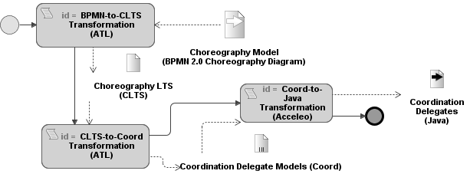
The synthesis process at a glance
BPMN2-to-CLTS model transformation
ATLAS Transformation Lang. - ATL model-to-model transformation
  From BPMN2 specification to CLTS specification
A CLTS is an extended LTS, called Choreography LTS

Slide 25
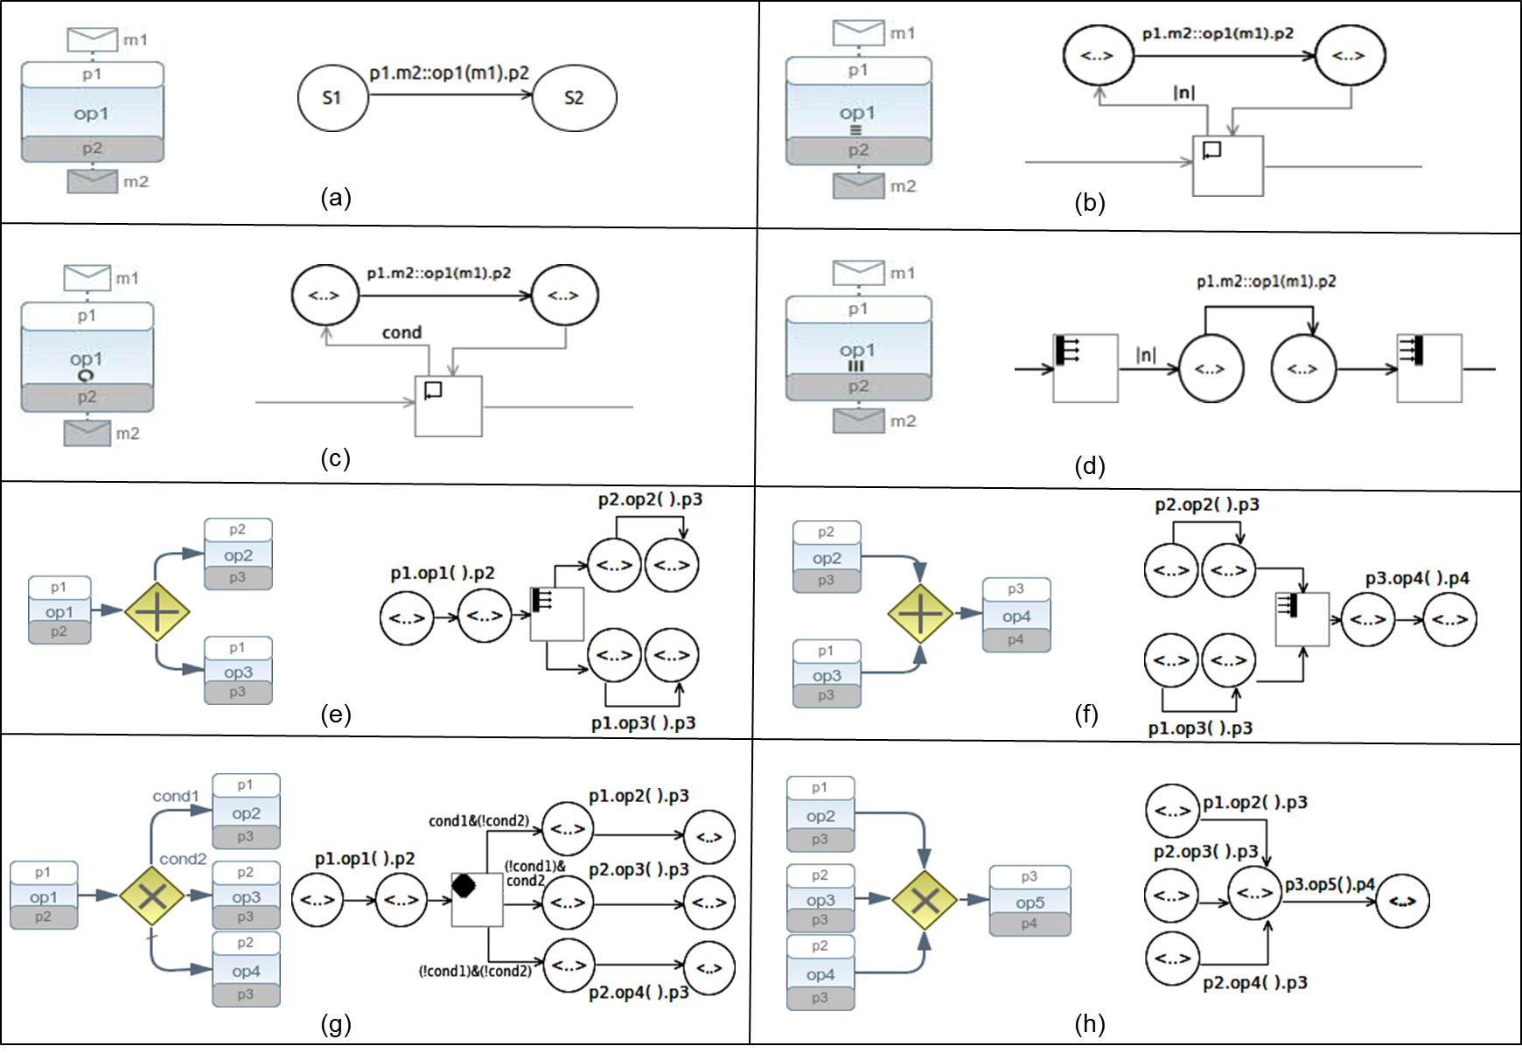
BPMN2-to-CLTS transformation (1/2)

Slide 26
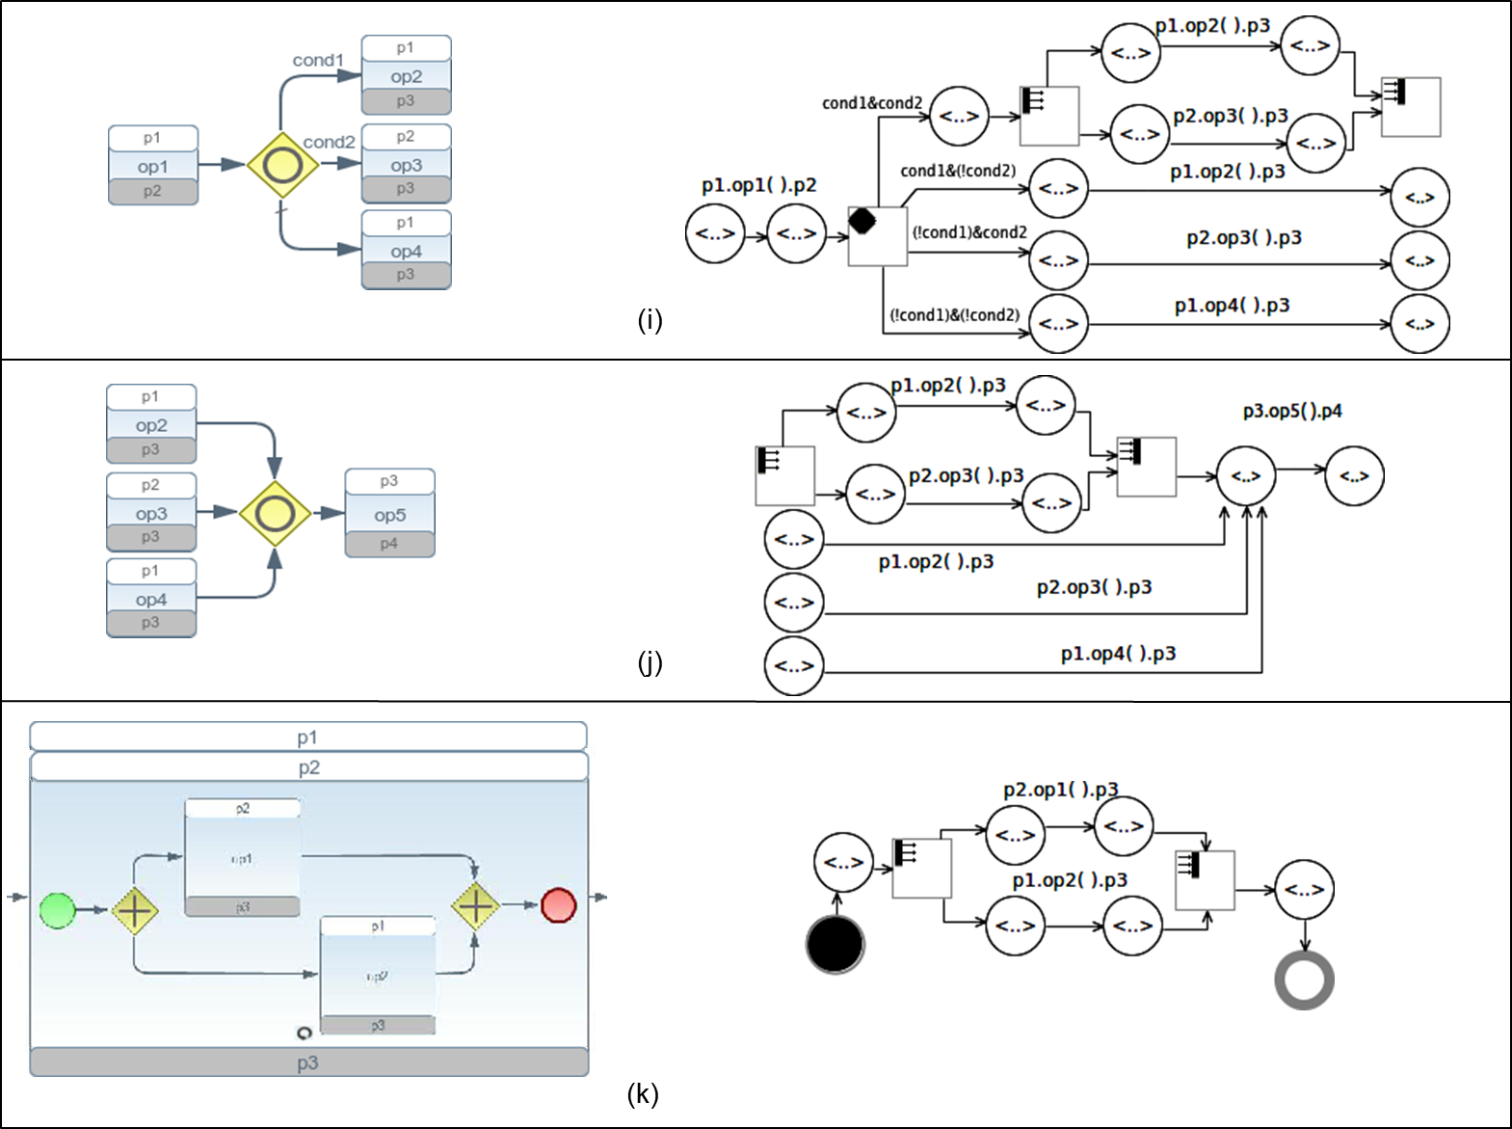
BPMN2-to-CLTS transformation (2/2)

Slide 27
BPMN2-to-CLTS

Slide 28
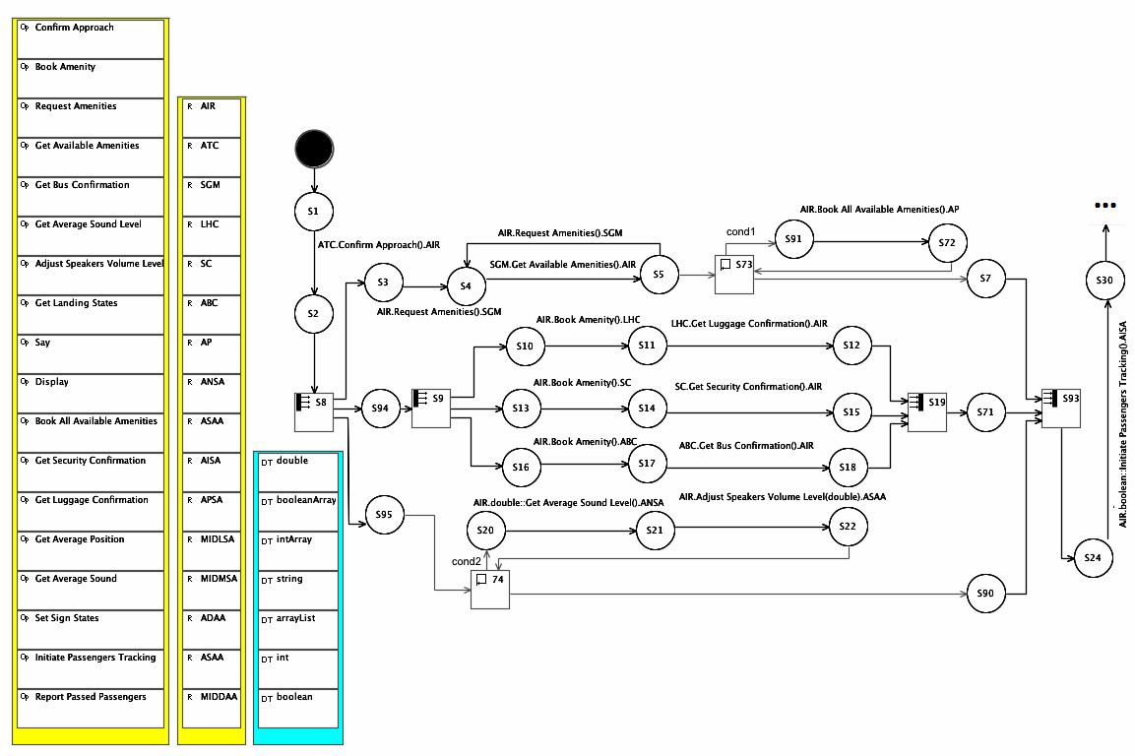
BPMN2-to-CLTS (1/2)

Slide 29
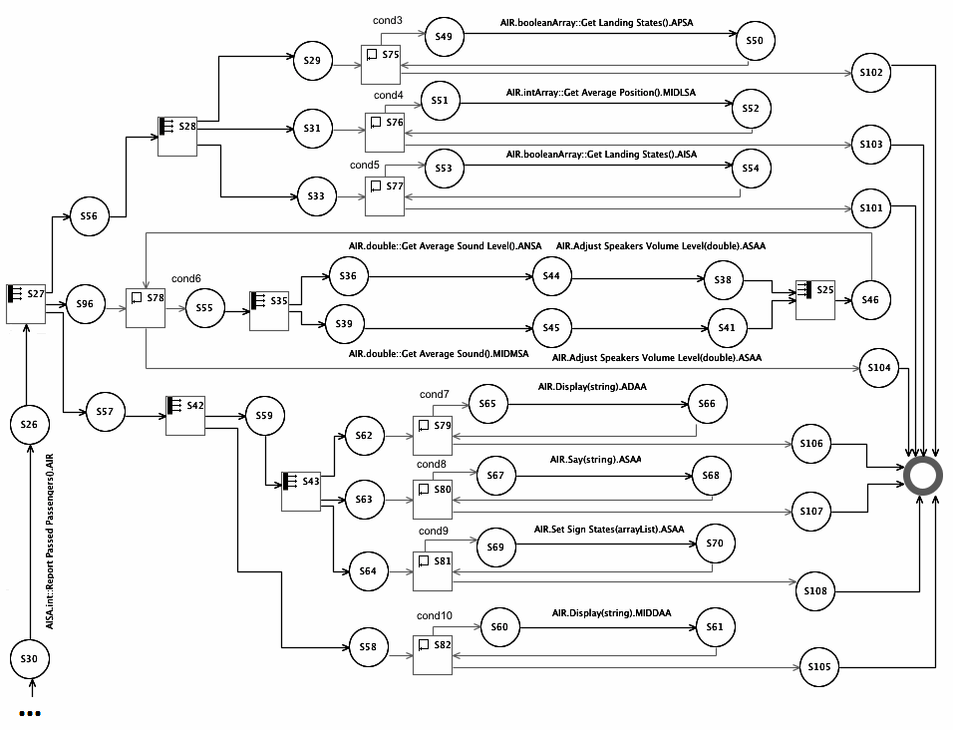
BPMN2-to-CLTS (2/2)

Slide 30
The synthesis process at a glance
CLTS-to-Coord model transformation
ATL model-to-model transformation
  From CLTS specification to Coordination Models
A Coordination Model specifies coordination information

Slide 31
CLTS-to-Coord model transformation
S1
S2
CD1
CD2
CM1
CM2
additional
communication
(coordination
Information)
CM3
CM4
CD3
CD4
S3
S4

Slide 32
Coordination Models
Coordination Model CM_{LuggageHC.Airport}
{
S11; ack::!GetLuggageConfirmation( ); S24;
CD(); CD(AIR.AISA);
luggageCondition;
Notify( S12 to CD(AIR.AP; SC.AIR; ABC.AIR; AIR.ASAA) );
Wait( S7 from CD(AIR.AP);
S15 from CD(SC.AIR); S18 from CD(ABC.AIR); S90 from CD(AIR.ASAA) )
}
…
…

Slide 33
The synthesis process at a glance
Coord-to-Java model transformation
Acceleo-based model-to-code transformation
  From Coordination Models to Java
For each model a set of Java class is generated by means of dedicated templates consisting of static and variable parts

Slide 34
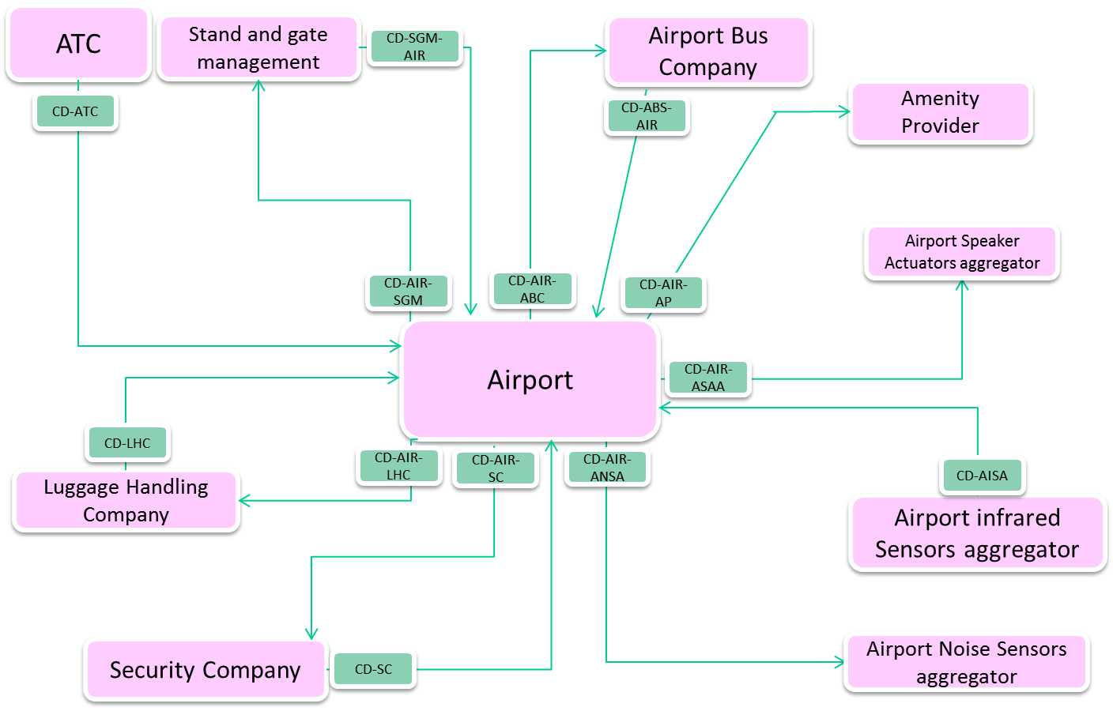
Overall architecture configuration

Slide 35
Conclusion and Future Work
Conclusion
Development process, and related supporting development and run-time environment, for the development of choreography-based service-oriented systems
Preliminary validation against the CHOReOS use cases
Future Work
Finalize the process and the supporting environment
Finalize the validation

Slide 36
Thank You

