Slide 1
Distributed Vertex Coloring

Slide 2
Graph Coloring: given a graph G=(V,E) associate a color (i.e., a label) with each vertex, according to some constraint

Slide 3
Vertex Coloring: each vertex is assigned a color so that any two adjacent nodes have different color
Valid vertex coloring
Invalid vertex coloring

Slide 4
W.l.o.g., each color can be
represented by an integer

Slide 5
W.l.o.g., each color can be represented by an integer:
a valid coloring with k colors
Example:

Slide 6
Chromatic number :
The smallest number of colors that
need to be used to give a valid coloring
of a graph
Finding the chromatic number of a graph is a well-known NP-hard problem. It can be approximated within a factor of O(n(log log n)²(log n)⁻³), and for all ε>0, approximating it within a factor of n^{1−ε} is NP-hard.

Slide 7
Sequential -coloring
We first show that for any graph
there is a -coloring (∆ is the degree of G)
Therefore,

Slide 8
Basic idea for:
Each node keeps a color Palette
of size :
Color:
: degree of node

Slide 9
Color Palette of node
Color:
Suppose that neighbors of
have picked colors

Slide 10
Color Palette of node
Color:
available
color
unavailable
color
Number of available colors: X ≥ δ(v)+1-r
(uncolored neighbors)
At least one
available color

Slide 11
Color Palette of node
Color:
Still, a color is available
Worst case scenario:
every neighbor has
a different color

Slide 12
Color Palette of node
Color:
Node can pick color for itself

Slide 13
Sequential Coloring Algorithm
Mark all entries in the palettes of all the nodes as available
Repeat:
1. Pick an uncolored node
2. Let be an available color (from ‘s palette)
(such a color always exists)
3. Color node with color
4. Mark as unavailable in the color
palette of every neighbor of
Until all nodes are colored

Slide 14
Example execution
Palette of
All are available colors

Slide 15
Palette of
Pick first available color

Slide 16
Palette of

Slide 17
Palette of
Pick first available color

Slide 18
Palette of
Pick first available color

Slide 19
Palette of
Pick first available color

Slide 20
Termination

Slide 21
From sequential to distributed Vertex Coloring: a relationship with MIS
In a valid coloring, the nodes of same
color form an independent set
Independent Set

Slide 22
However, the independent set may
not be maximal:
New Independent set (Maximal)

Slide 23
Vertex Coloring is reduced to MIS
Consider an uncolored graph
Coloring algorithm for using MIS:
Repeat:
Find a MIS in the uncolored nodes;
Assign color to each node in MIS;
Until every node is colored;

Slide 24
Example:
initially, all nodes are uncolored

Slide 25
Iteration 1:
Find a MIS of the uncolored nodes
and give to the nodes color

Slide 26
Iteration 2:
Find a MIS of the uncolored nodes
and give to the nodes color

Slide 27
Iteration 3:
Find a MIS of the uncolored nodes
and give to the nodes color

Slide 28
Lemma:
The algorithm terminates in at most
iterations
Proof:
At the end of an iteration, each uncolored node is adjacent to a node in the just found MIS

Slide 29
The degree in the
uncolored graph
Thus, the effective degree of each
uncolored node is reduced by at least
one at each iteration

Slide 30
After at most iterations, the degree
of each uncolored node becomes 0
At iteration each uncolored node
is isolated and then it enters in the last MIS
END OF PROOF
Observation: notice that the algorithm could use less than iterations, depending on the MIS selection at every iteration

Slide 31
Since the number of iterations is at most
we use at most colors
(at each iteration we use a different color)

Slide 32
Using the randomized MIS algorithm, we obtain a synchronous coloring algorithm which gives:
-coloring
in O(∆² log n) total number of rounds w.h.p.
∆ log n phases (and number of rounds) to compute a MIS
with high probability
#iterations

Slide 33
Using Luby’s randomized MIS algorithm, we obtain a synchronous coloring algorithm which gives:
-coloring
in total number of rounds
Phases (and number of rounds) to compute a MIS
with high probability
#iterations

Slide 34
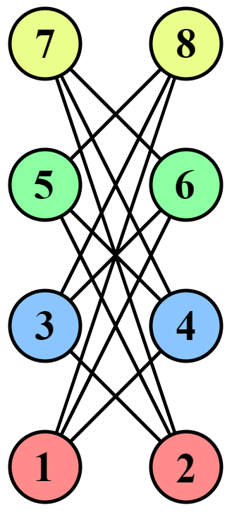
How good is a MIS-based approximation?
It can be quite bad, namely in the order of n: look to this example in which we are given a bipartite graph of degree 3 (i.e., a 2-colorable graph), where a 4-coloring (in general, an n/2 coloring) is found (numbers in the nodes are associated with the order in which the MIS are found at each iteration)

Slide 35
A Simple Randomized -Coloring Algorithm
Distributed Synchronous (not really needed) Algorithm
Randomized Algorithm:
# rounds:
with high probability
( is the number of nodes)

Slide 36
Each node has a palette with colors
Palette of node
Initially all colors in palette are available
(Recall: is the node’s degree)

Slide 37
The algorithm works in phases
At the beginning of a phase,
there are two kinds of nodes:
colored
uncolored

Slide 38
Palette of node
unavailable
color
available
color

Slide 39
Palette of node
Node chooses randomly and uniformly
an available color

Slide 40
Palette of node
At the same time, uncolored neighbors
pick randomly a color too (from their palettes)

Slide 41
Palette of node
If then node accepts color
for all
and exits the algorithm

Slide 42
Palette of node
If then node rejects color
for some
Conflict

Slide 43
Palette of node
All the nodes that conflict reject their
colors and try again in the next phase

Slide 44
Algorithm for node
Repeat (iteration = phase)
Pick a color uniformly at random
from available palette colors;
Send color to neighbors;
If (some neighbor chose same color )
Then Reject color ;
Else Accept color ;
Inform neighbors about color ;
(so that they mark color as unavailable)
Until color is accepted;

Slide 45
Example execution

Slide 46
Phase 1: (iteration 1 of synchronous execution)
Nodes pick random colors
Conflicts

Slide 47
Successful Colors

Slide 48
Phase 2:
(iteration 2)
Nodes pick random colors
Conflicts

Slide 49
Successful Colors

Slide 50
Phase 3:
(iteration 3)
Nodes pick random colors

Slide 51
End of execution

Slide 52
Analysis
Consider phase
(iteration )
Palette of node
unavailable
color
available
color
Set of available colors:
Example:

Slide 53
: set of neighbors of
which are uncolored at the
beginning of the phase
Example:

Slide 54

At the beginning of phase
Palette of node

Slide 55
: available colors after every
node in chooses a random color
Palette of node
Color used by
Color in

Slide 56
Palette of node
Since at most colors in
are used by neighbors

Slide 57
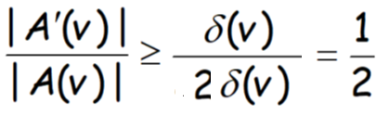
A successful color choice for node :
node has picked a color in
(this color is not picked by any neighbor)
Probability of success:
space of successful random choices
space of all random choices

Slide 58
Probability that node succeeds
in a phase:
at least
Probability that node fails
for phases:
at most

Slide 59
Probability that node fails
for phases:
at most
Probability that some node fails
for phases:
at most
Probability that every node succeeds
in the first phases:
at least

Slide 60
Duration of each phase:
rounds (easy to be seen)
The algorithm terminates in phases
with probability at least
Total # rounds:
(with high probability)
Remark: the sequential (Δ+1)-coloring algorithm (which was making use of the δ(v)+1-palette) can be distributed in order to obtain a (Δ+1)-coloring in O(log n) rounds w.h.p., but the analysis is much harder

Slide 61
Homework
Design and analyze a randomized (3/2)∙Δ -coloring distributed algorithm (suggestion: modify the palette of the 2∙Δ-coloring algorithm)

